Slide 1
Principal Component Analysis (PCA)

Slide 2
Introduction to PCA
PCA (Principal Component Analysis)
An effective method for reducing a dataset’s dimensionality while keeping spatial characteristics as much as possible
Characteristics:
For unlabeled data
A linear transform with solid mathematical foundation
Applications
Line/plane fitting
Face recognition
Machine learning
...

Slide 3

Story

Slide 4



Story Starts ☺
I heard you are studying "Pee-See-Ay". I wonder what that is...
Ah, it's just a method of summarizing some data.
Look, we have some wine bottles standing here on the table. We can describe each wine by its colour, by how strong it is, by how old it is
We can compose a whole list of different characteristics of each wine in our cellar.
But many of them will measure related properties and so will be redundant.
If so, we should be able to summarize each wine with fewer characteristics! This is what PCA does.

Slide 5
Story Continues ☺
This is interesting! So this PCA thing checks what characteristics are redundant and discards them?
Excellent question, granny!
Nooooo, PCA is not selecting some characteristics and discarding the others. Instead, it constructs some new characteristics that turn out to summarize our list of wines well.
Of course these new characteristics are constructed using the old ones
for example, a new characteristic might be computed as wine age minus wine acidity level or some other combination like that (we call them linear combinations).
In fact, PCA finds the best possible characteristics, the ones that summarize the list of wines as well as only possible (among all conceivable linear combinations). This is why it is so useful.

Slide 6

Story Continues ☺
Hmmm, this certainly sounds good, but I am not sure I understand. What do you actually mean when you say that these new PCA characteristics "summarize" the list of wines?
I guess I can give two different answers to this question MOM
First answer is that you are looking for some wine properties (characteristics) that strongly differ across wines. Indeed, imagine that you come up with a property that is the same for most of the wines. This would not be very useful, wouldn't it? Wines are very different, but your new property makes them all look the same! This would certainly be a bad summary. Instead, PCA looks for properties that show as much variation across wines as possible.

Slide 7
Story Continues ☺
Hmmm, this certainly sounds good, but I am not sure I understand. What do you actually mean when you say that these new PCA characteristics "summarize" the list of wines?
The second answer is that you look for the properties that would allow you to predict, or "reconstruct", the original wine characteristics.
Again, imagine that you come up with a property that has no relation to the original characteristics; if you use only this new property, there is no way you could reconstruct the original ones!
This, again, would be a bad summary. So PCA looks for properties that allow to reconstruct the original characteristics as well as possible.

Slide 8

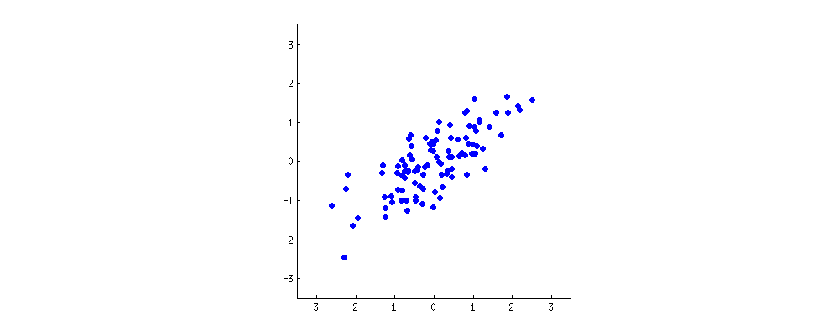
Story Continues ☺
Hey, these two "goals" of PCA sound so different! Why would they be equivalent?
Hmmm. Perhaps I should make a little drawing (takes a napkin and starts scribbling).
Let us pick two wine characteristics, perhaps wine darkness and alcohol content -- I don't know if they are correlated, but let's imagine that they are.
Here is what a scatter plot of different wines could look like:

Slide 9
Story Continues ☺
Each dot in this "wine cloud" shows one particular wine. You see that the two properties (x and y on this figure) are correlated.
A new property can be constructed by drawing a line through the center of this wine cloud and projecting all points onto this line.
This new property will be given by a linear combination w1x+w2y, where each line corresponds to some particular values of w1 and w2.
Now look here very carefully -- here is how these projections look like for different lines (red dots are projections of the blue dots):

Slide 10

Story Continues ☺
PCA will find the "best" line according to two different criteria of what is the "best".
First, the variation of values along this line should be maximal. Pay attention to how the "spread" (we call it "variance") of the red dots changes while the line rotates; can you see when it reaches maximum?
Second, if we reconstruct the original two characteristics (position of a blue dot) from the new one (position of a red dot), the reconstruction error will be given by the length of the connecting red line. Observe how the length of these red lines changes while the line rotates; can you see when the total length reaches minimum?
If you stare at this animation for some time, you will notice that "the maximum variance" and "the minimum error" are reached at the same time, namely when the line points to the magenta ticks
"first principal component"

Slide 11

Story Continues ☺
Very nice, papa! I think I can see why the two goals yield the same result: it is essentially because of the Pythagoras theorem, isn't it?
Mathematically, the spread of the red dots is measured as the average squared distance from the center of the wine cloud to each red dot - as you know, it is called the variance.
On the other hand, the total reconstruction error is measured as the average squared length of the corresponding red lines. But as the angle between red lines and the black line is always 90∘, the sum of these two quantities is equal to the average squared distance between the center of the wine cloud and each blue dot; this is precisely Pythagoras theorem.
Of course this average distance does not depend on the orientation of the black line, so the higher the variance the lower the error (because their sum is constant).
By the way, you can imagine that the black line is a solid rod and each red line is a spring.
The energy of the spring is proportional to its squared length (this is known in physics as the Hooke's law), so the rod will orient itself such as to minimize the sum of these squared distances.

Slide 12
PCA
Common goal: Reduction of unlabeled data
PCA: dimensionality reduction
Objective function: Variance ↑

Slide 13
Examples of PCA Projections
PCA projections
2D ➔ 1D
3D ➔ 2D

Slide 14
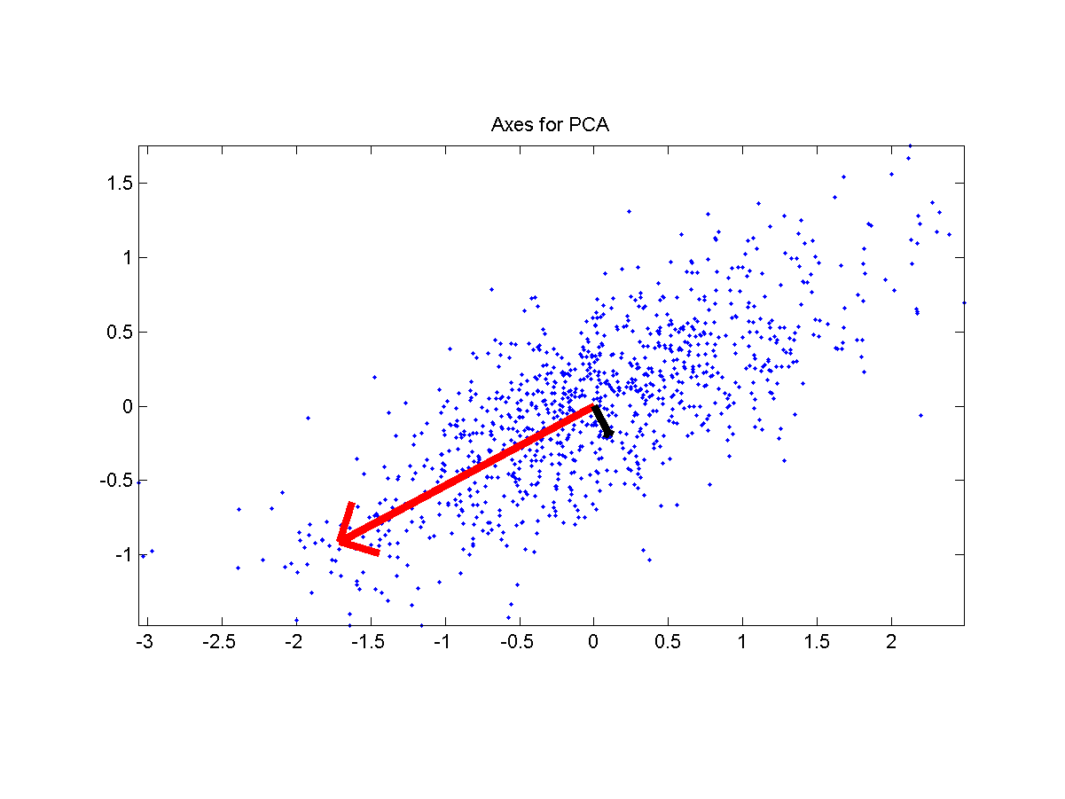
Problem Definition
Quiz!
Input
A dataset X of n d-dim points which are zero justified:
Output
A unity vector u such that the square sum of the dataset’s projection onto u is maximized.

Slide 15
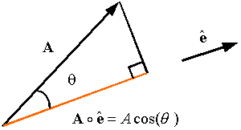
Projection
Angle between vectors
Projection of x onto u
Quiz!
Extension: What is the projection of x onto
the subspace spanned by u₁, u₂, …, u_{m}?

Slide 16
Steps for PCA
Find the sample mean:
Compute the covariance matrix:
Find the eigenvalues of C and arrange them into descending order, with the corresponding eigenvectors
The transformation is , with

Slide 17
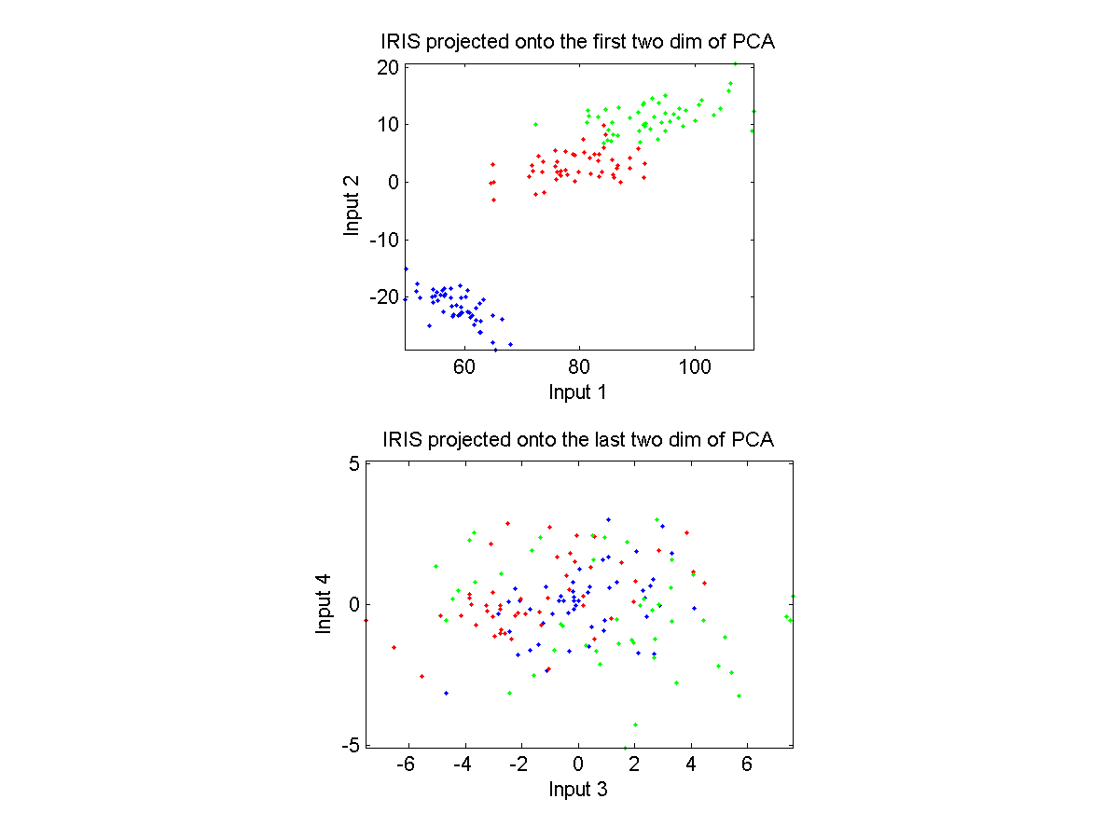
Example of PCA
IRIS dataset projection

Slide 18
Weakness of PCA for Classification
Not designed for classification problem (with labeled
training data)
Ideal situation
Adversary situation

Slide 19
Is rotation necessary in PCA? If yes, Why? What will happen if you don’t rotate the components?
Yes, rotation (orthogonal) is necessary because it maximizes the difference between variance captured by the component. This makes the components easier to interpret. Not to forget, that’s the motive of doing PCA where, we aim to select fewer components (than features) which can explain the maximum variance in the data set. By doing rotation, the relative location of the components doesn’t change, it only changes the actual coordinates of the points.
If we don’t rotate the components, the effect of PCA will diminish and we’ll have to select more number of components to explain variance in the data set.

